Slide 1
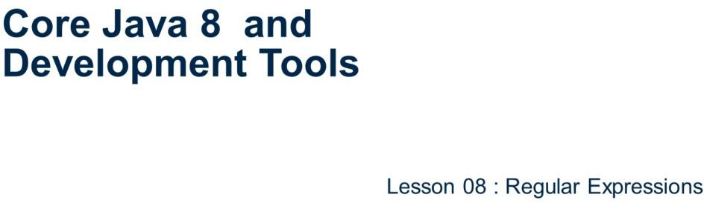
Core Java 8 and Development Tools
Regular Expressions

Slide 2
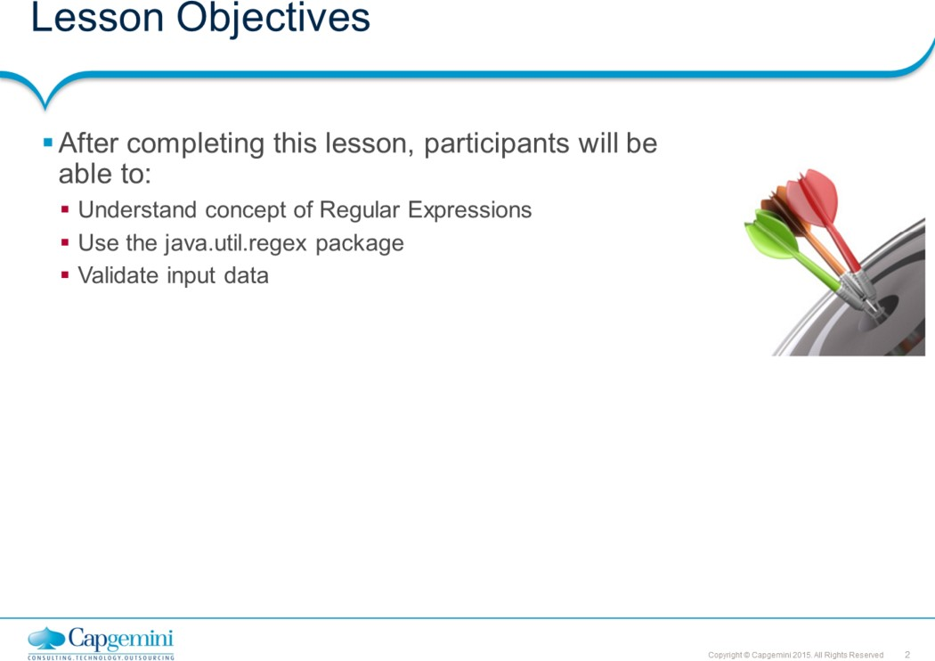
Core Java 8
and Development Tools
Regular Expressions
Lesson Outline:
: Regular Expressions
: Validating data
: Best Practices

Slide 3
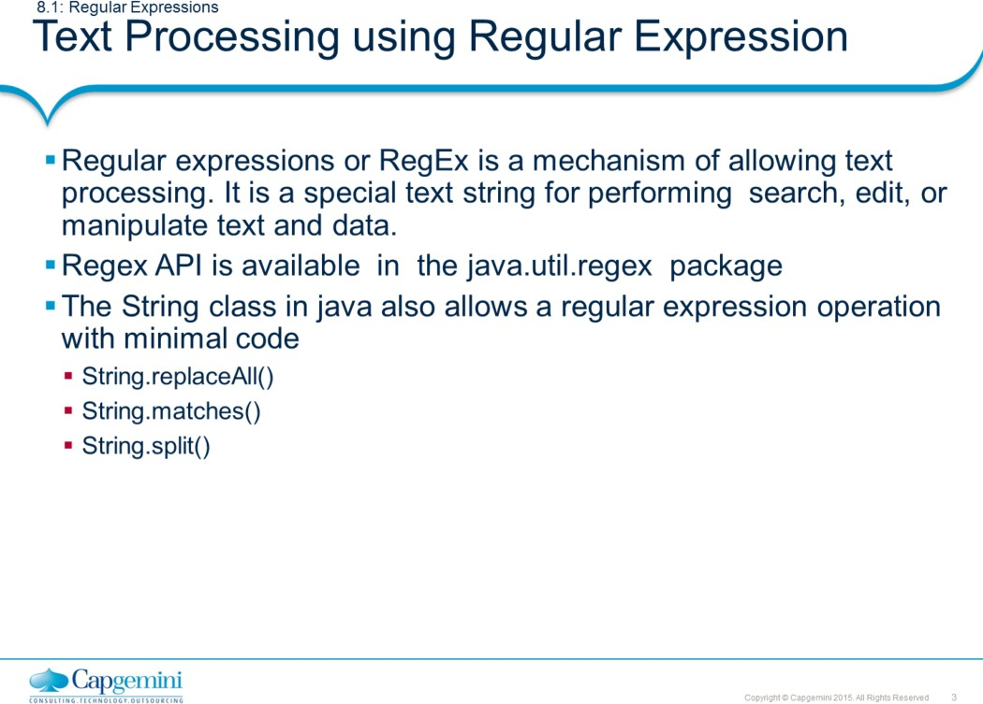
Core Java 8
and Development Tools
Regular Expressions
Regular Expressions are basically patterns of characters which are used to perform certain useful operations on the given input. The operations include finding particular text, replacing the text with some other text, or validating the given text.
For example, we can use Regular Expression to check whether the user input is
valid for a field like Email-id or a telephone number.
Supported in most of the common languages like C, Java, Python, C# etc. Support is slightly different for regex in each of these languages though.
The Java String class has several methods that allow you to perform an operation using a regular expression on that string in a minimal amount of code. Some of them are listed above. For example, myString.matches("regex") returns true or false depending whether the string can be matched entirely by the regular expression.

Slide 4
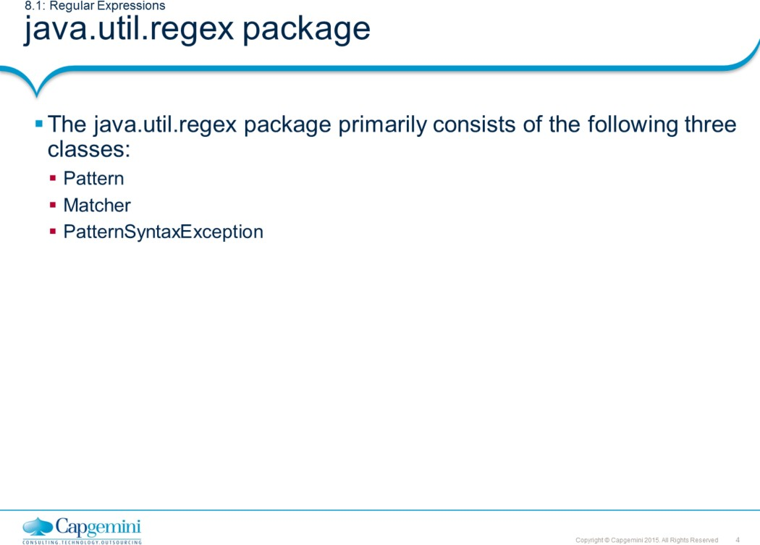
Core Java 8
and Development Tools
Regular Expressions
The java.util.regex package primarily consists of the following three classes: Pattern Class: An instance of this class is a compiled representation of a regular expression. This class provides no public constructors. To create a pattern, you must first invoke one of its public static compile methods, which will then return a Pattern object. These methods accept a regular expression as the first argument. Matcher Class: An instance of this class is the engine that interprets the pattern and performs match operations against an input string. Like the Pattern class, Matcher defines no public constructors. A Matcher instance is created by invoking the matcher() method on a Pattern object.
PatternSyntaxException: A PatternSyntaxException object is an unchecked exception that indicates a syntax error in a regular expression pattern. It has various methods like getDescription(), getIndex(), getMessage() and getPattern() that provide details of the error.

Slide 5
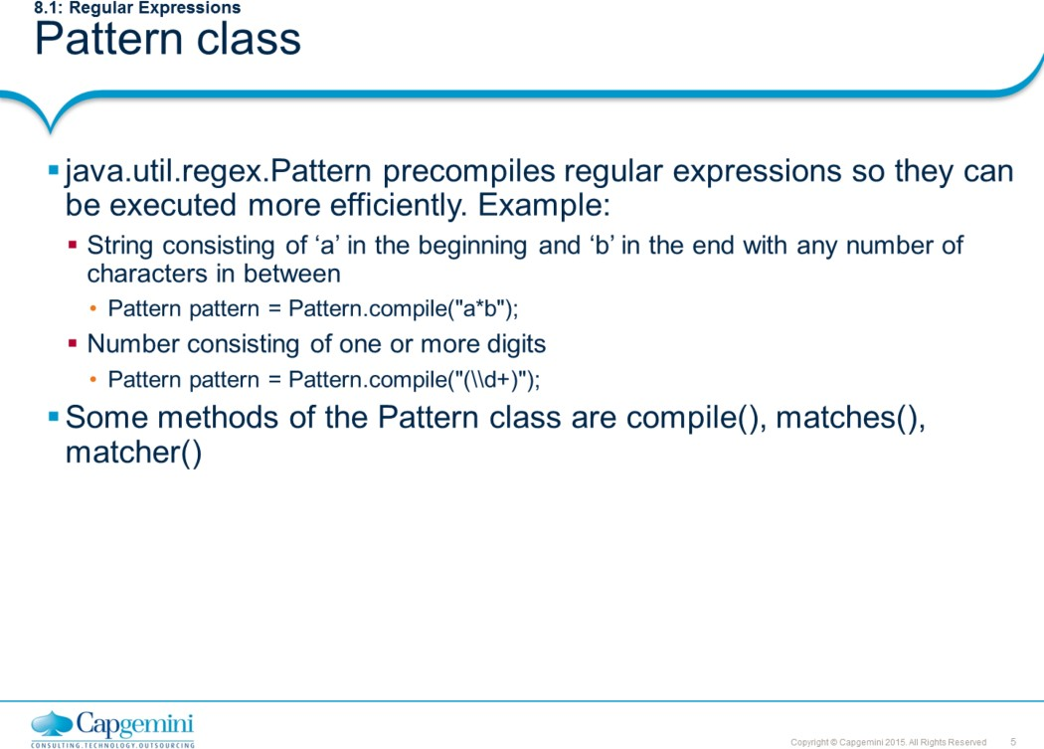
Core Java 8
and Development Tools
Regular Expressions
Some methods of the Pattern class:
compile (String regex) : This method returns a new Pattern object which is a compiled form of regular expression pattern. Note that compile() is a static method.
matcher (String input ) : This method is used to create new Matcher object for an input for a given pattern, which can be used to perform matching operations.
matches (pattern, inputSequence ) : This method returns true only if the entire input text matches the pattern. This method internally depends on the compile() and matcher() methods of the Pattern object. Note that matches() is a static method.

Slide 6
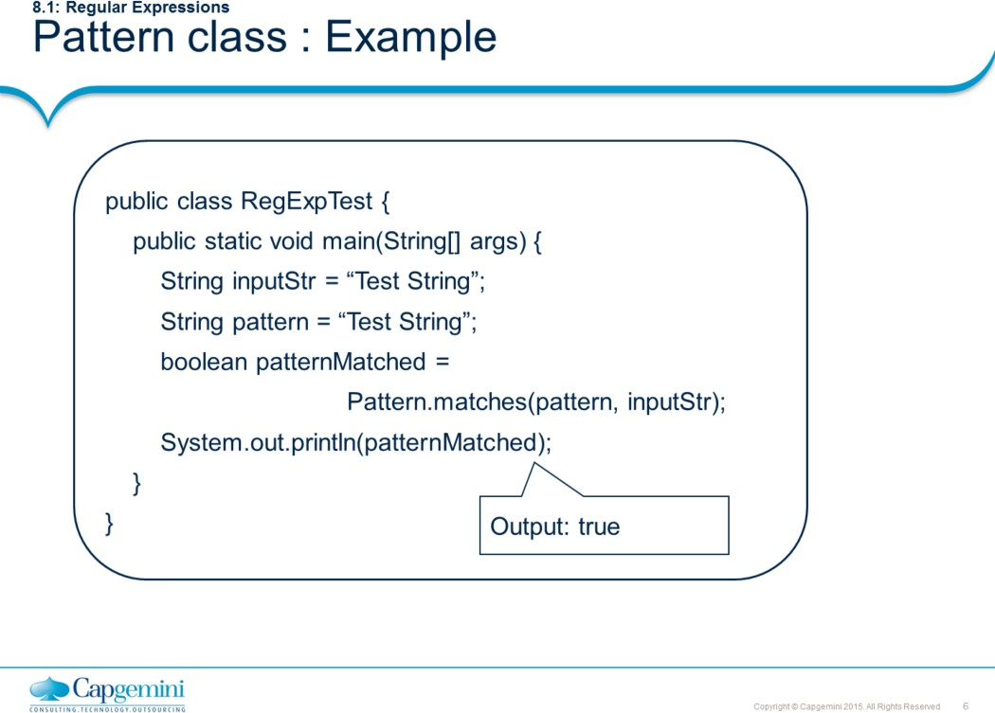
Core Java 8 and Development Tools
Regular Expressions

Slide 7
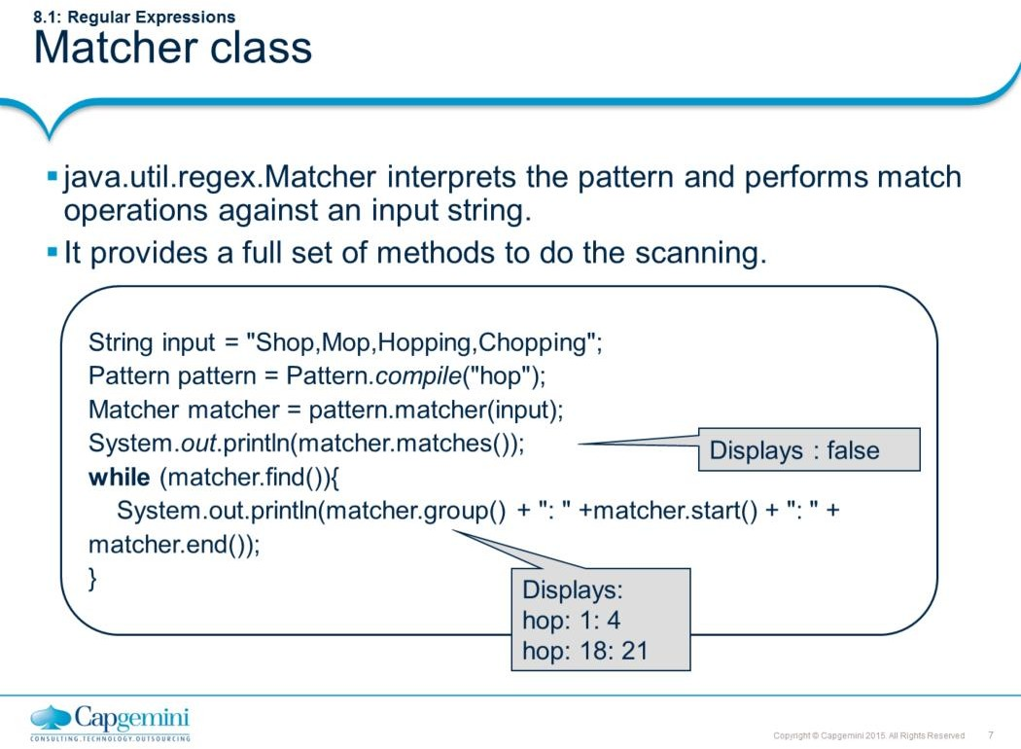
Core Java 8
and Development Tools
Regular Expressions
Please refer to Javadocs for details about the methods of this class.
In the code snippet above, the first output returns false since the entire input string " Shop,Mop,Hopping,Chopping " does not match the regular expression pattern “hop" and hence matches() method returns false.

Slide 8
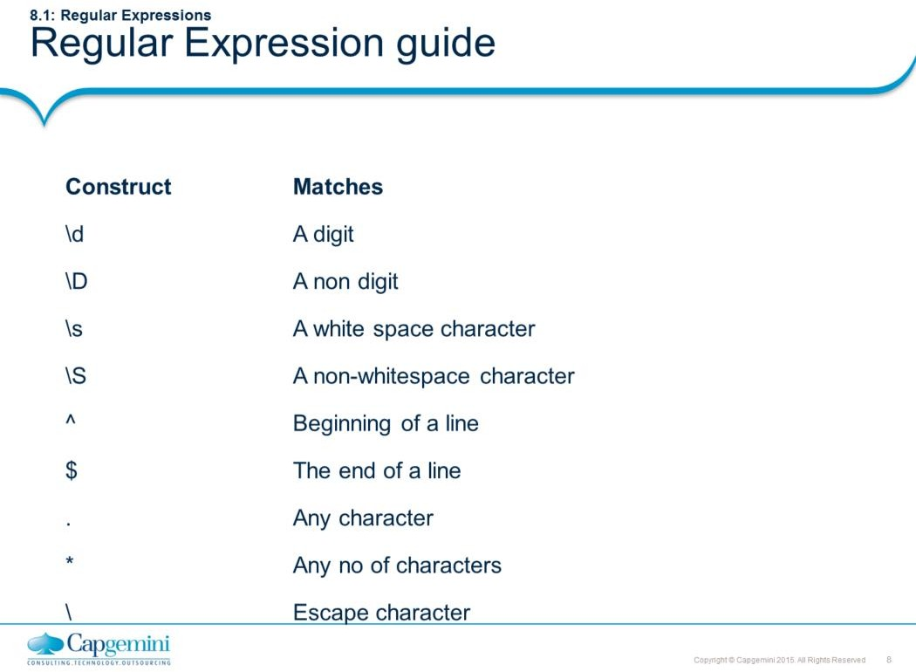
Core Java 8
and Development Tools
Regular Expressions
This API supports a number of special characters (metacharacters) that affect the way a pattern is matched.
To treat a metacharacter as an ordinary character, precede it with a backslash (\)

Slide 9
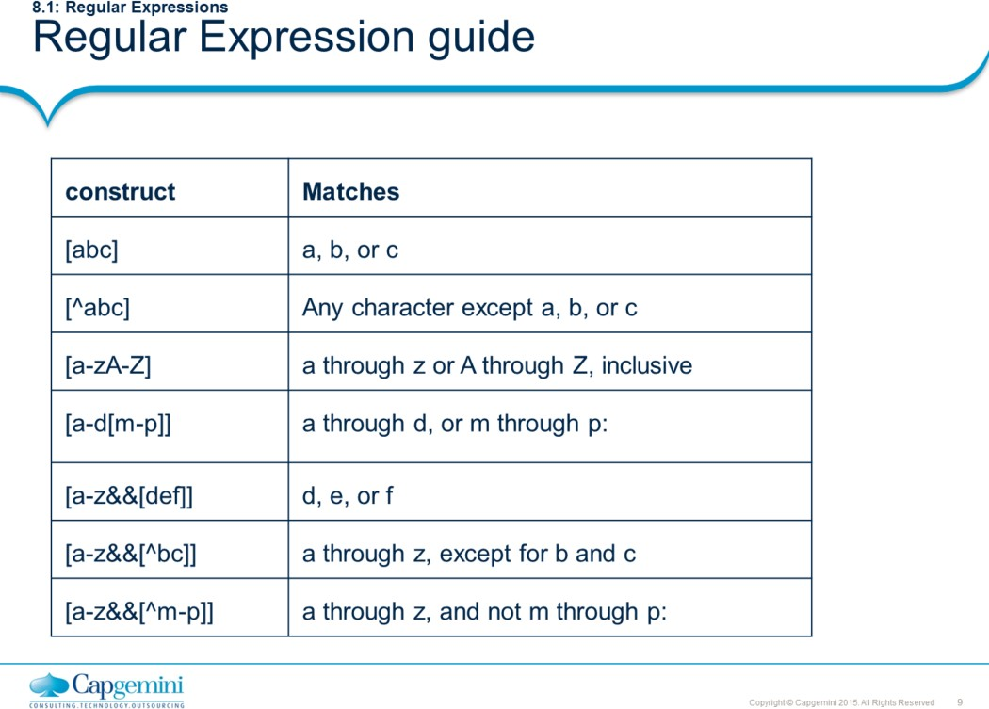
Core Java 8
and Development Tools
Regular Expressions
Please browse through the Pattern class specification in Javadocs. There are tables summarizing the supported regular expression constructs.

Slide 10
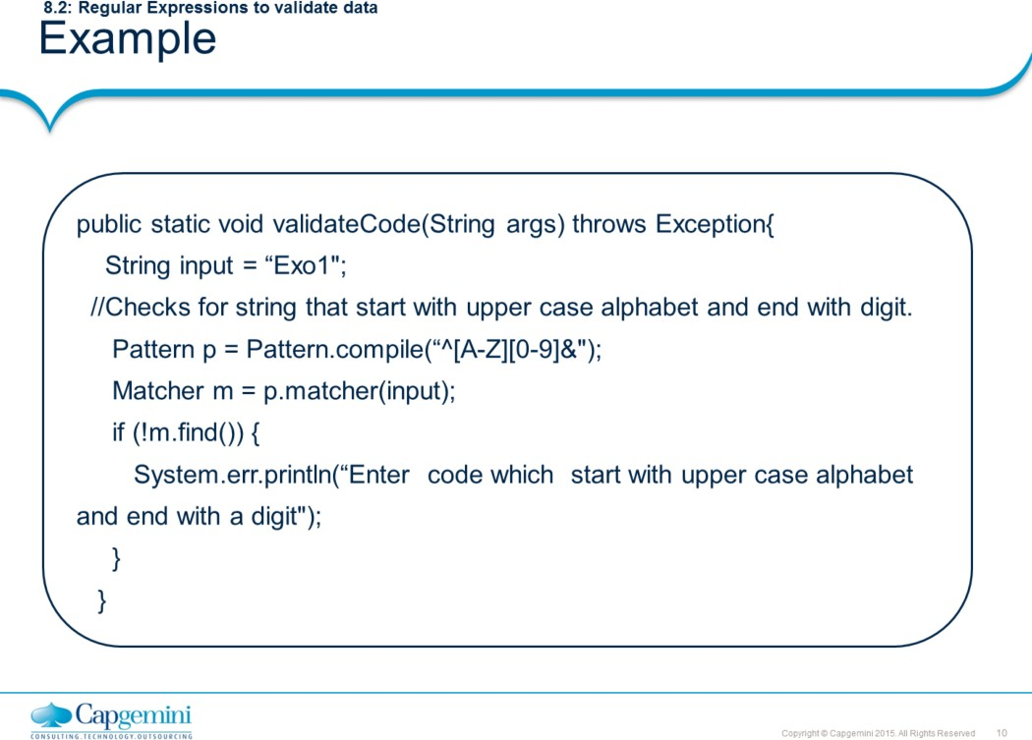
Core Java 8 and Development Tools
Regular Expressions

Slide 11
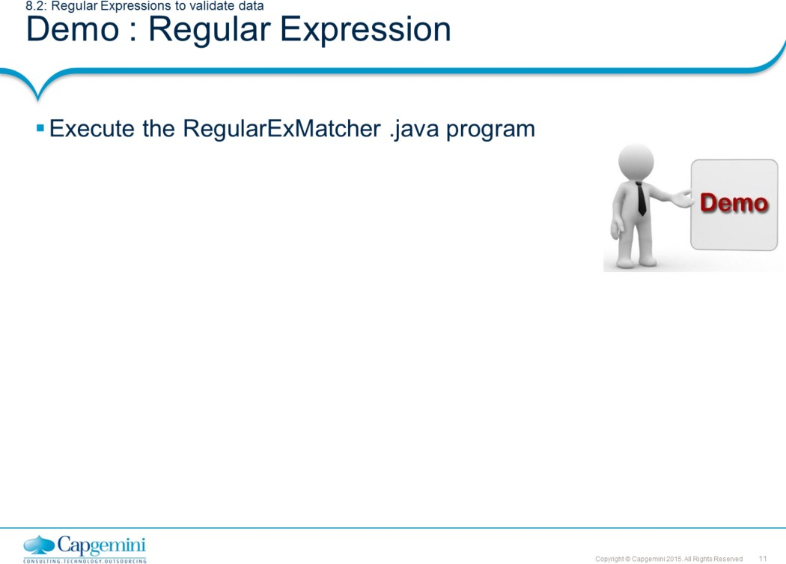
Core Java 8 and Development Tools
Regular Expressions

Slide 12
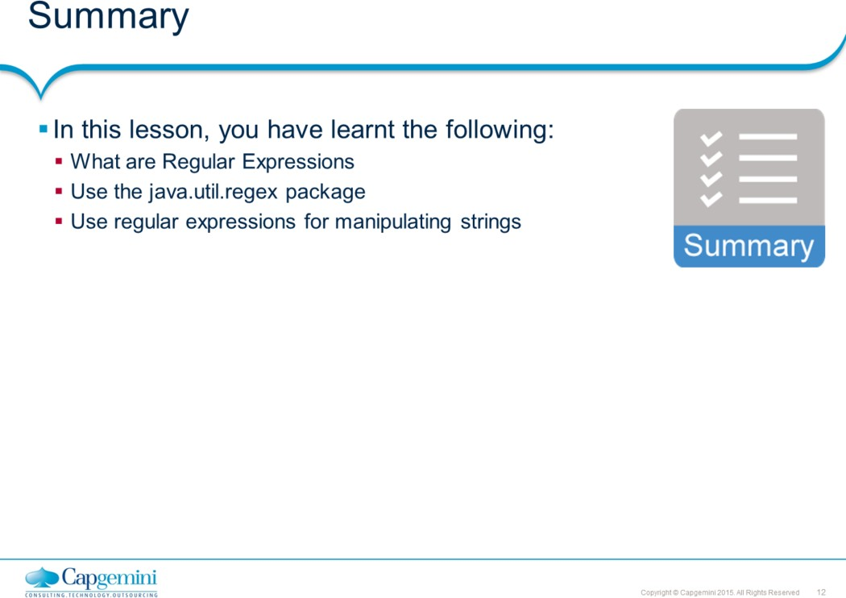
Core Java 8 and Development Tools
Regular Expressions

Slide 13
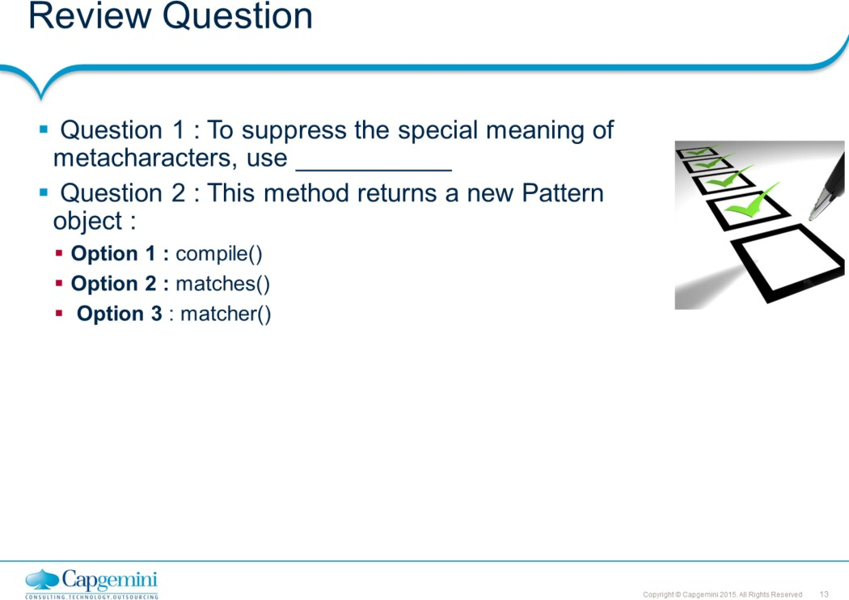
Core Java 8 and Development Tools
Regular Expressions

